Slide 1
ML ANALYSIS OF PLAYER STATS DATASET
Utku OzyiGit 20211314043
ISHAK ORCUN AYDEMIR 20222905026

Slide 2
PROBLEM STATEMENT
Dataset Used: player_stats.csv
This dataset contains performance statistics of players (e.g., rating, KD ratio, total maps, etc.)
Objective: To analyze the data to examine player performance, cluster similar players, and prepare the data for further modeling steps.

Slide 3
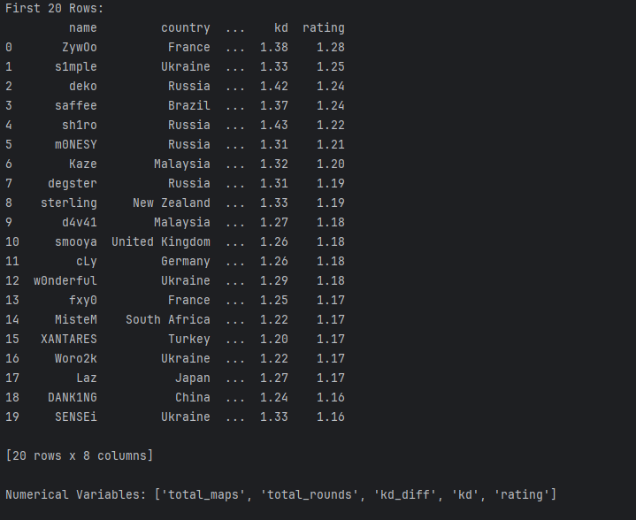
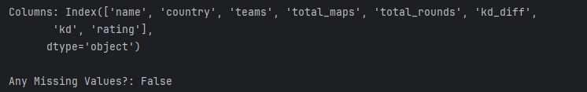
DATASET GENERAL INFORMATION
Here, we listed the first 20 players and displayed their key attributes ('name', 'country', 'kd', 'rating'). We also checked whether there were any missing values in the dataset.

Slide 4
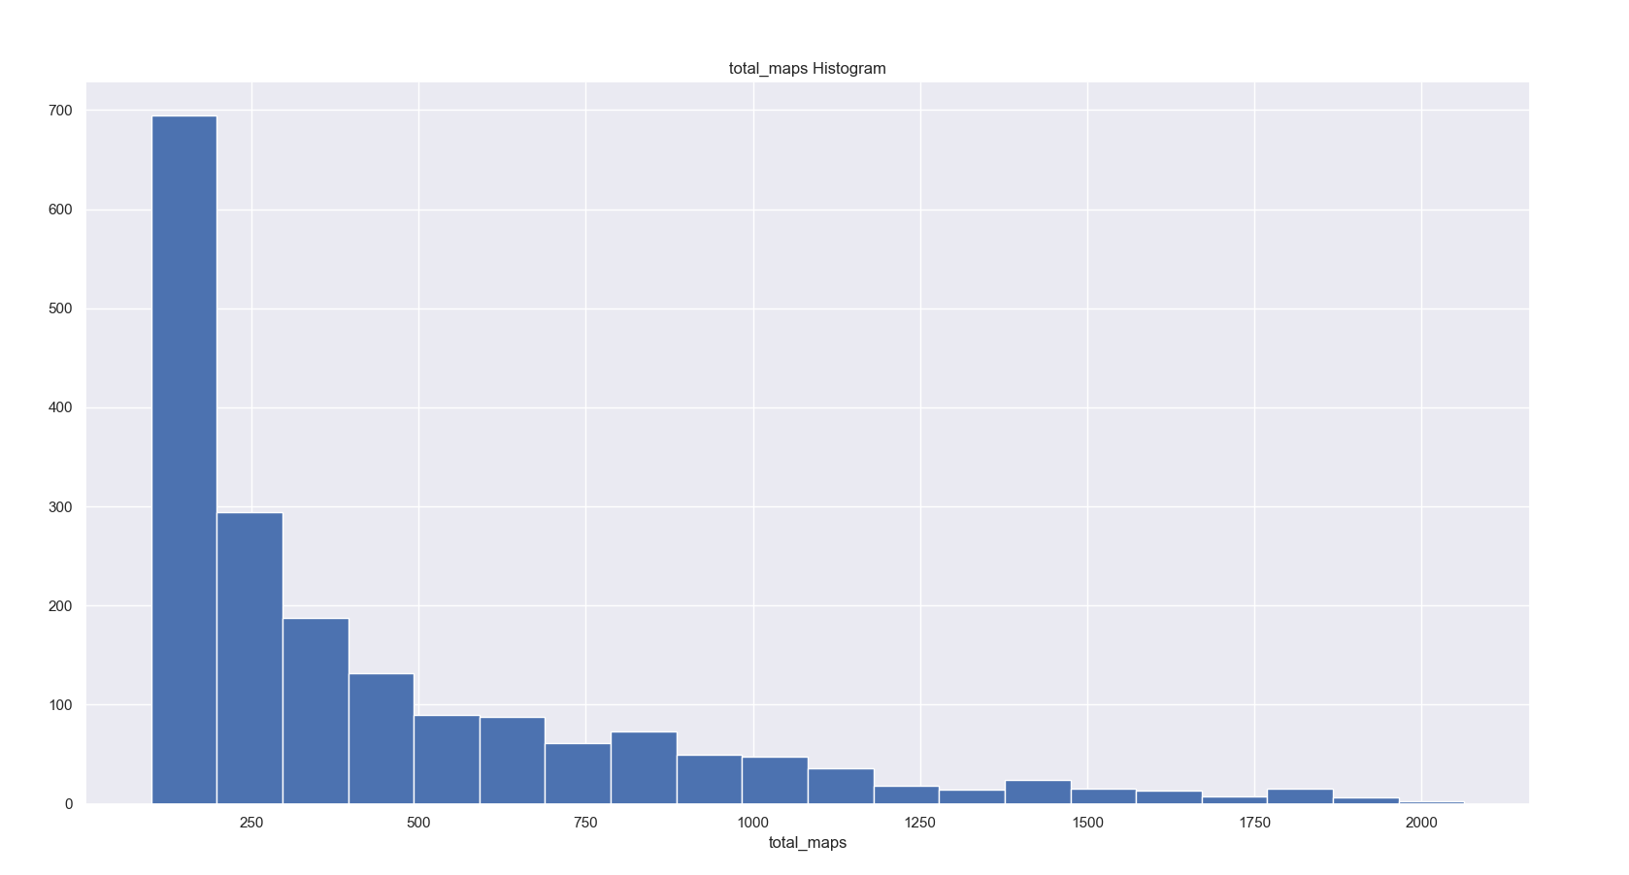
We have presented all the maps played here visually. The same applies to the other visuals.

Slide 5
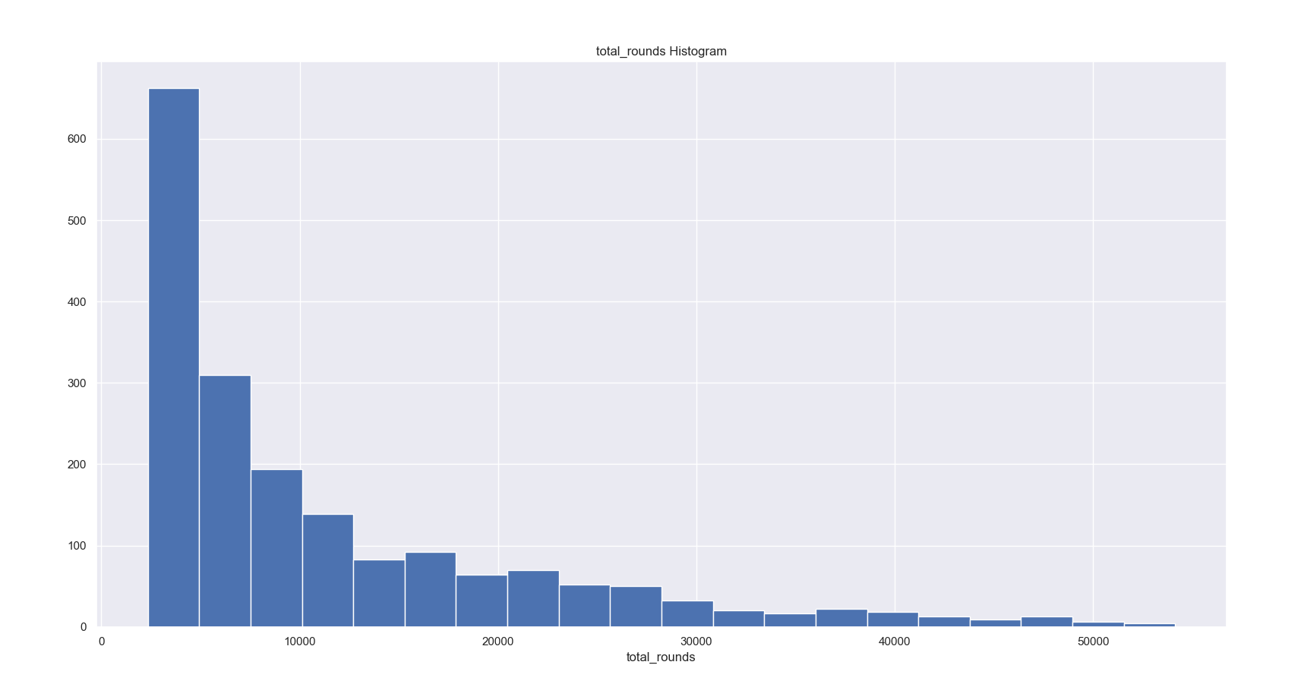

Slide 6
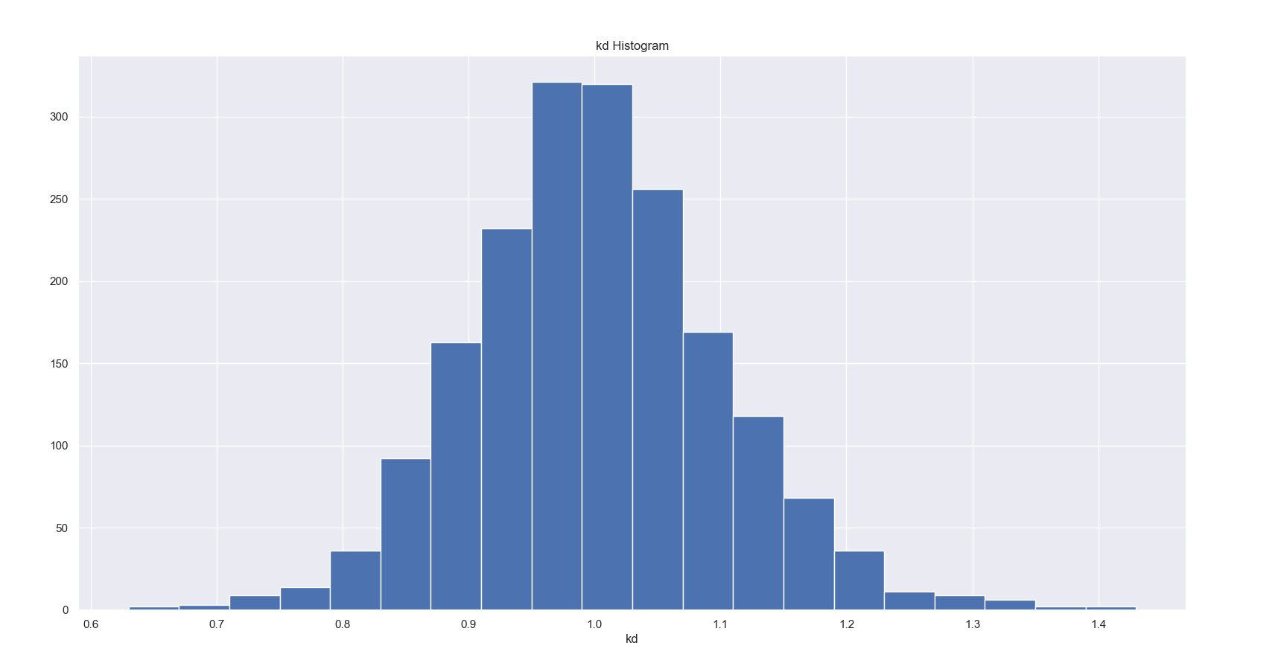
The term KD refers to the number of kills and deaths a player has during the match.

Slide 7
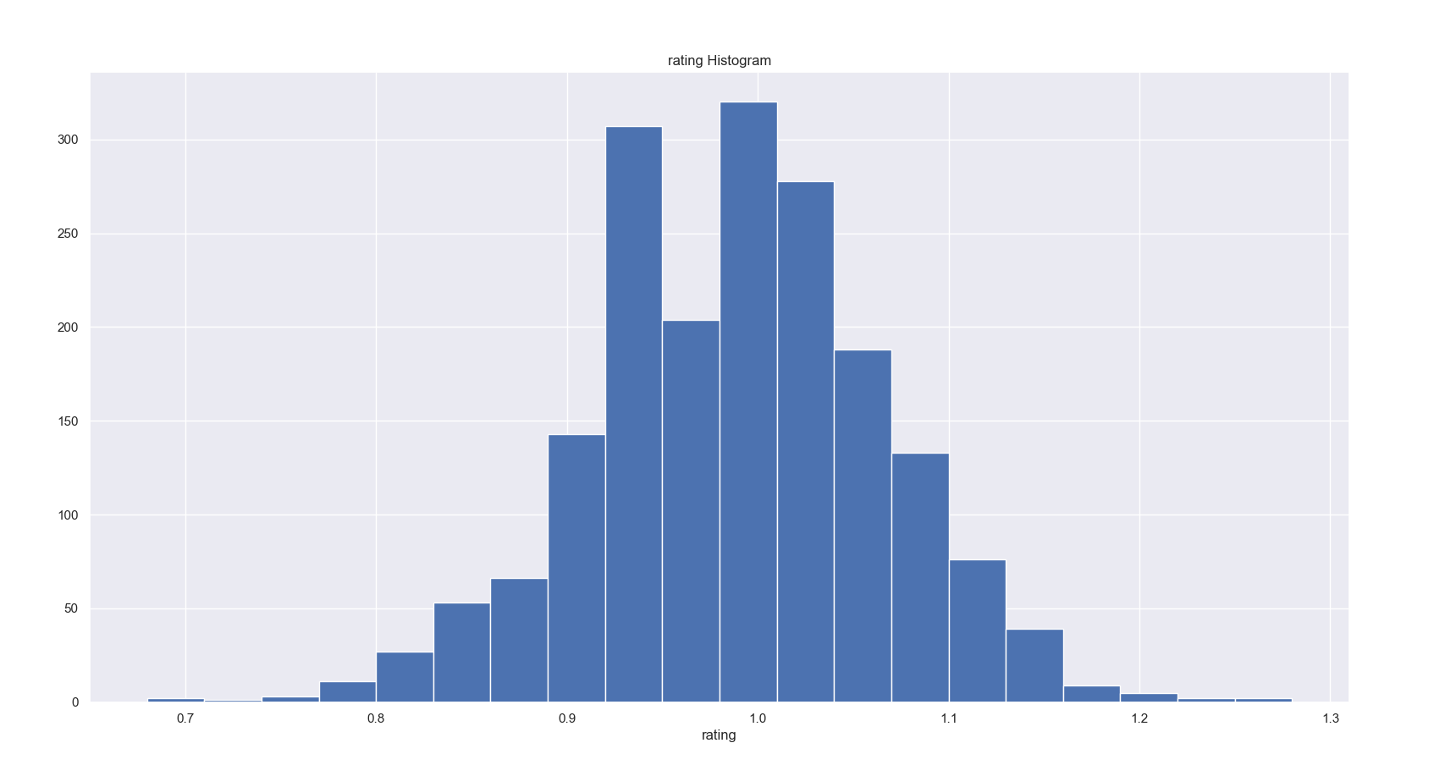
The concept of Rating reflects the player's overall statistics. For example, it covers their matches over the last 3 months. Additionally, categories like opening, entrying, and firepower also contribute to it.

Slide 8
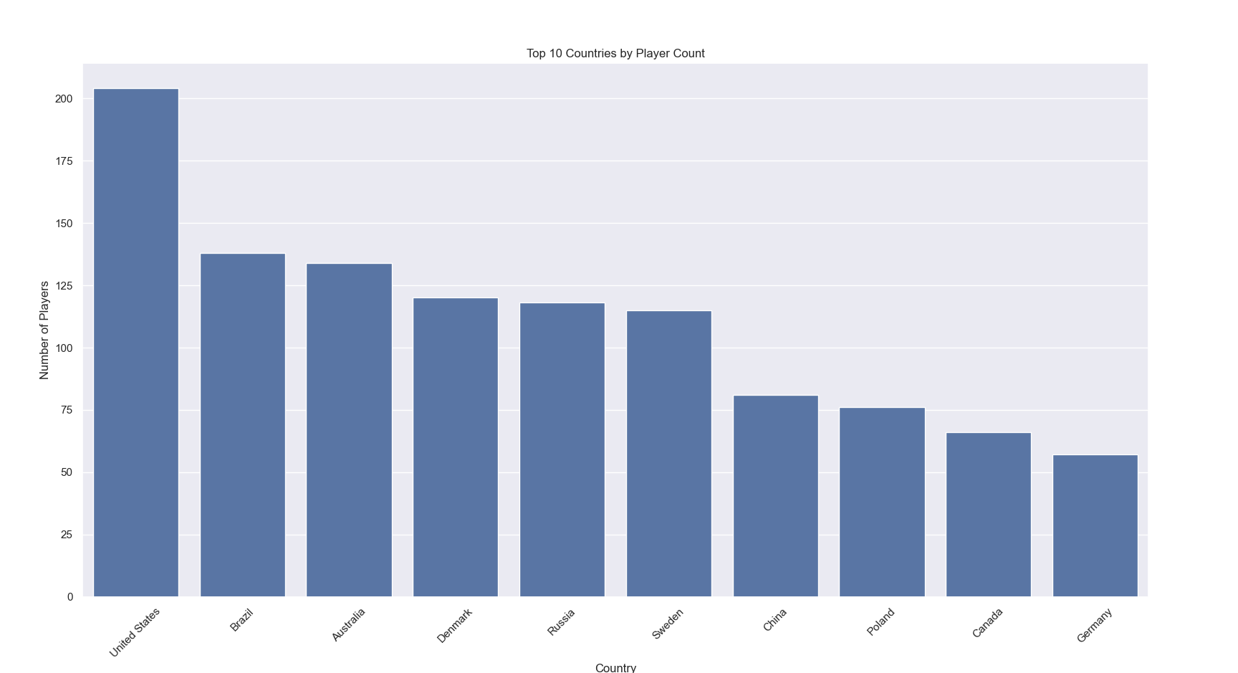
Here, we have ranked the countries with the highest number of players.

Slide 9
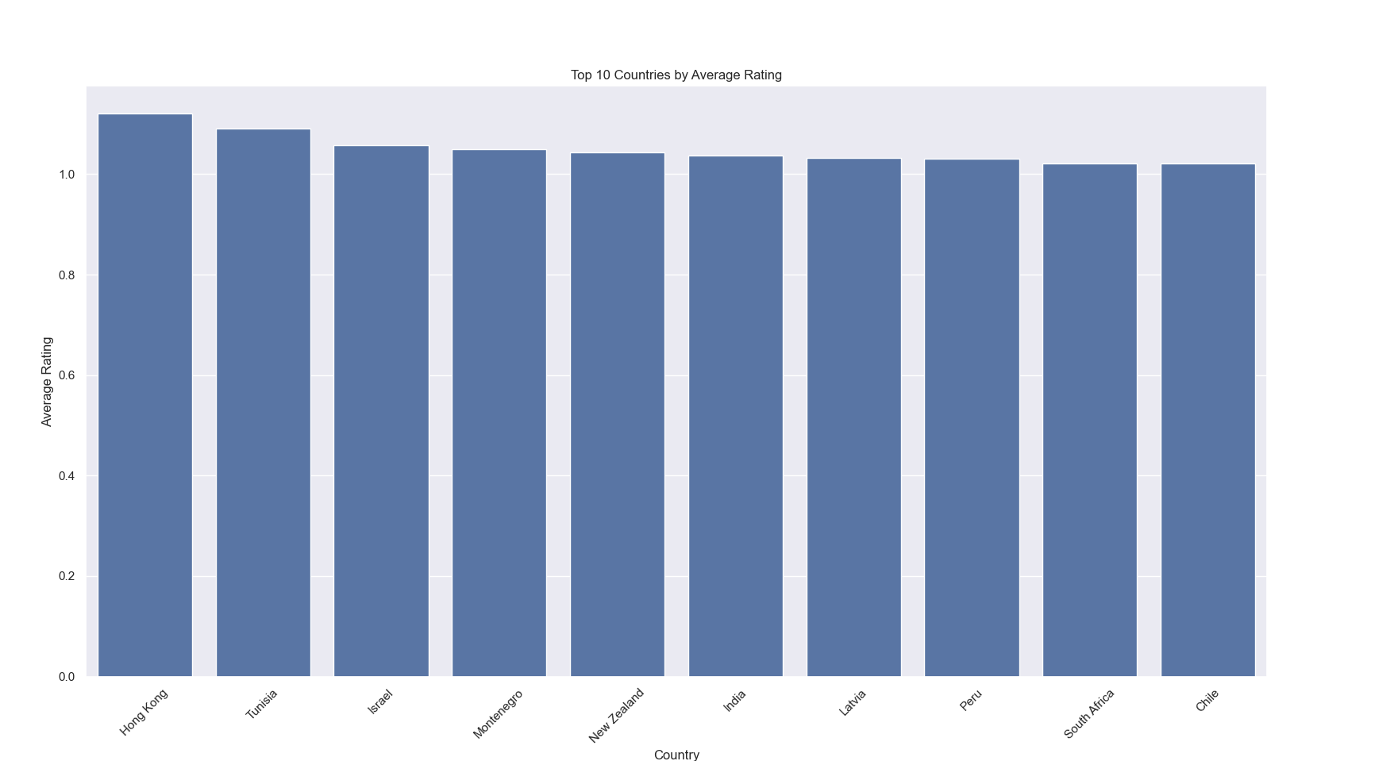
Here, the concept of rating by country is presented.

Slide 10
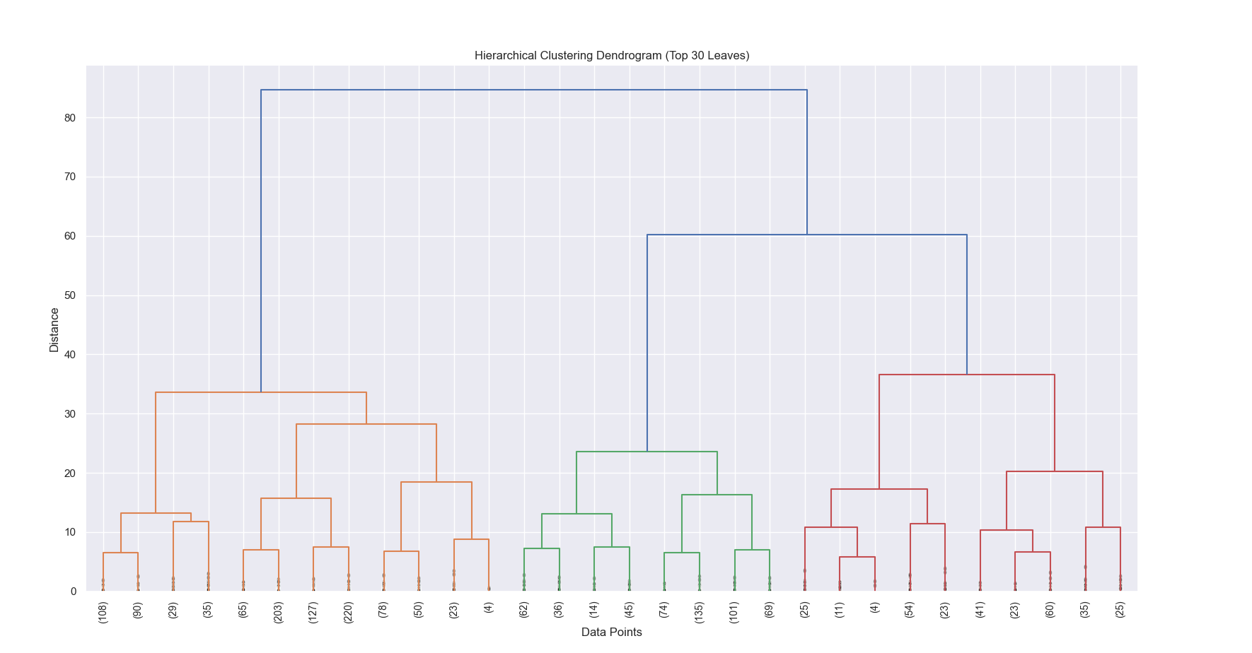
We visualized the hierarchical clustering based on similarity between players using a dendrogram. The X-axis represents the players (or clusters), and the Y-axis reflects the dissimilarity (distance) between clusters. Players that merge at lower points are more similar to each other. Using the Ward method, we created clusters while keeping the variance to a minimum.

Slide 11
This allows the graph to help determine the meaningful number of clusters, and branches that merge higher up show player groups that are more distinct from each other.

Slide 12
THANK YOU FOR LISTENING

